Slide 1
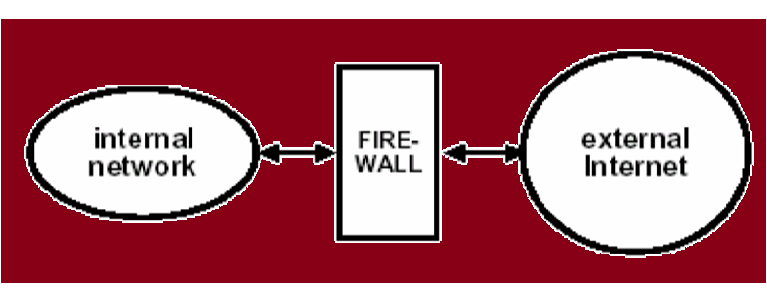
Firewall
A firewall may be a hardware, software or a combination of both that is used to prevent unauthorized program or internet users accessing a private network or a single computer.

Slide 2
All message entering or leaving the intranet pass through the firewall, which examines each message & blocks those that do not meet the specified security criteria.
A Firewall provides secure connectivity between networks(internal/external).

Slide 3

Why need of Firewall
To protect confidential information from those who do not explicitly need to access it.
To protect our network & its resources from malicious users & accidents that originate outside of our network.

Slide 4
Types of Firewall
Hardware Firewall
Software Firewall

Slide 5
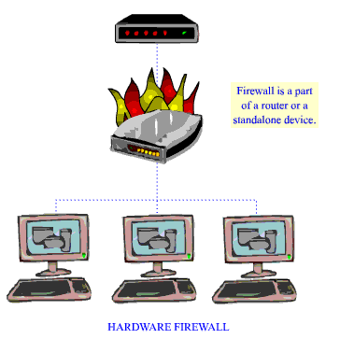
Hardware Firewall
It is a physical device.
It can be installed between the modem and computer.
It can be incorporated into a broadband router being used to share the internet connection.

Slide 6
Protect an entire network.
Usually more expensive, header to configure
E.g.- Cisco pix, netscreen, watchfuard etc.

Slide 7
Hardware Firewall-Advantages
Uses very little system resources.
More secure
Enhanced security control
Dedicated hardware firewalls are typically more reliable
Easy to disable or remove
Work independently of associated computer system.

Slide 8
Hardware Firewall-Disadvantages
Install process is more demanding both physically and mentally.
Takes up physical work space
More expensive
Harder to upgrade and repair

Slide 9
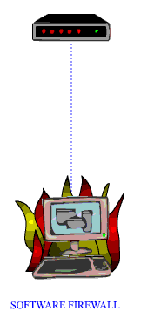
Software Firewall
It is a software application.
It is installed onto the computer system that you wish to protect.

Slide 10
Protect a single computer.
Usually less expensive, easier to configure.
E.g.:- Norton internet security, MacAfee internet security etc.

Slide 11
Software Firewall-Advantages
Considerably cheaper or even free.
Simple to install and upgrade
Requires no physical changes to hardware or network
Ideal for home/family use
Takes up no physical space.

Slide 12
Software Firewall-Disadvantages
Software may crash or be incompatible with system
Can be difficult to completely disable & especially remove
Software bugs may compromise security
Can be resource hungry
Incompatibilities with OS.

Slide 13
Types of Firewall Technique
Packet filter
Application gateway/proxy server/proxy application gateway
Circuit-level gateway
Bastion host

Slide 14
Packet filter
It looks at each packet entering or leaving the network accepts or rejects it based on user-defined rules.
Applications
Applications
Presentations
Presentations
Sessions
Sessions
Transport
Transport
Network
Network
Data Link
Data Link
Data Link
Physical
Physical
Physical
Router

Slide 15
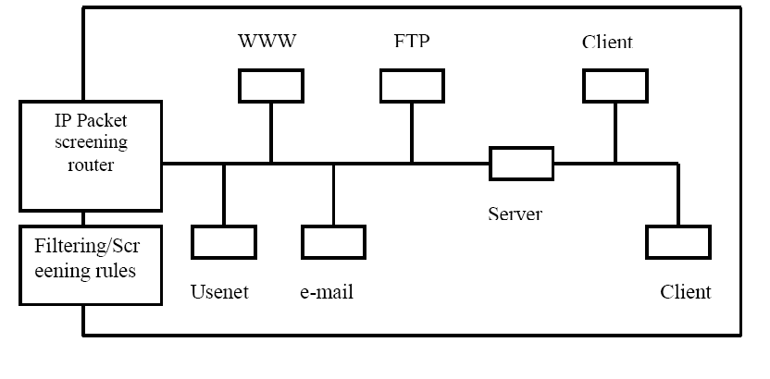
Packet filtering is fairly effective & transparent to users, but it is difficult to configure.
In addition, it is susceptible to IP spoofing.

Slide 16
Drawback of packet filtering technique:
Packet filtering rules can be complex.
Logging facility is not provided by such firewall.
If TCP/IP packet filtering is not implemented fully, it can lead to security hole.
Cannot handle RPC (remote procedure calls)

Slide 17
Application gateway/proxy server/proxy application gateway
In such type of firewall remote host or network can interact only with proxy server, proxy server is responsible for hiding the details of the internal network i.e. intranet.
Users uses TCP/IP application, such as FTP & Telnet servers.

Slide 18
Telnet
FTP
HTTP
Applications
Applications
Applications
Presentations
Presentations
Presentations
Sessions
Sessions
Sessions
Transport
Transport
Transport
Network
Network
Network
Data Link
Data Link
Data Link
Physical
Physical
Physical
Application Gateway

Slide 19
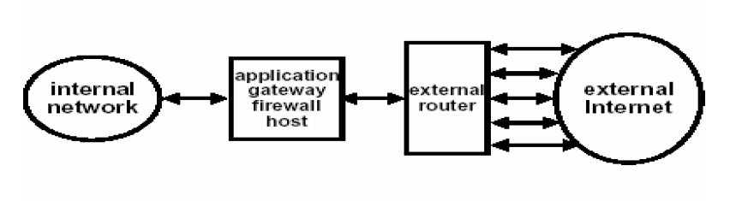
This is very effective, but can impose a performance degradation.

Slide 20
Advantages of application gateway:-
Less complex filter rules
Cost effectiveness
Robust authentication & logging facility
Proxy authenticates only those services for which it is configured/installed.

Slide 21
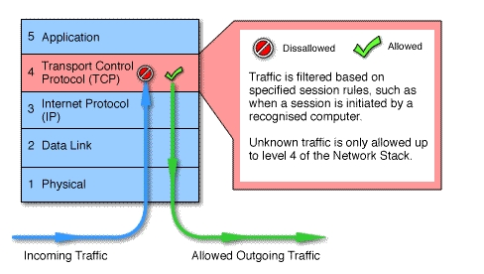
Circuit-level Gateway
It is a stand alone application.
It does not permit end-to-end TCP connection. it sets up 2 TCP connection:-
Between itself and a TCP user on an inner host.
Between itself and a TCP user on an outer host.

Slide 22
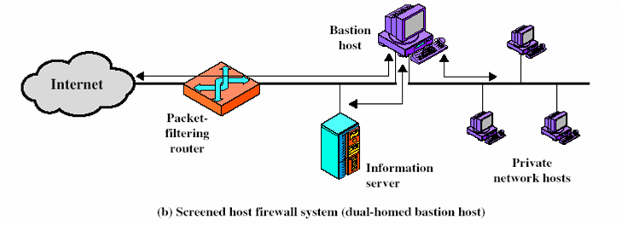
Bastion Host
Bastion host is a special purpose computer on a network specifically designed and configured to withstand attacks.

Slide 23
It generally hosts a single application, provides platform for application gateway and circuit-level gateway.
It supports limited/specific applications to reduce the threat to the computer.
Include application-Telnet, SMTP, FTP.

Slide 24

What a personal firewall can do
Stop hackers from accessing your computer.
Protect your personal information.
Blocks “pop up” ads and certain cookies.
Determines which programs can access the internet.
Block invalid packets.

Slide 25

What a personal firewall can not do
Cannot prevent e-mail
viruses
-only an antivirus product
with update definitions
can prevent e-mail viruses.
After setting it initially,
you cannot forget about it
-The firewall will require
periodic updates to the rule sets and the software itself.
Virus
Deadly

Slide 26
Manufacturing Companies
Cisco system, Inc.
Nortel networks corporation
Juniper networks, Inc.
MacAfee, Inc.
3com corporation
Citrix systems, Inc

